Slide 1




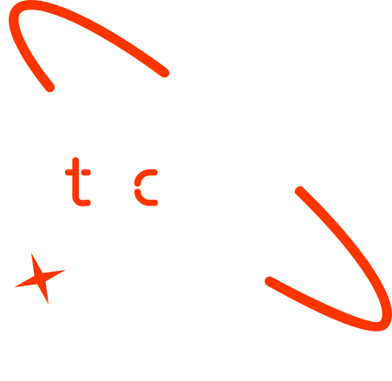

AI Powered Amharic
Sign Language Translator
Group 10
June 17, 2025

Slide 2

Outline
Concept note and implementation plan
Background
Objectives
SDG Relation
Data
Data Collection
Exploratory Data Analysis et Feature Engineering
Model
Model Selection and Training
Model Evaluation and Hyperparameter Tuning
Model Refinement and Testing
Results
Evaluation Results
Deployment
Future Work

Slide 3
Concept note and Implementation Plan
Notes:
FTs like precision agriculture, remote sensing & AI-powered forming equipment can help increase agricultural productivity in LDCs. This can improve fiid security & contribute to the achievement of SDG 2 (Zero Hunger).

Slide 4
Background
Sign language is a primary communication tool for millions of deaf and hard-of-hearing individuals.
It uses gestures, facial expressions, and body movements-forming a full linguistic system distinct from spoken languages.
In Ethiopia, users of Amharic Sign Language face significant communication barrier in education, healthcare and daily life.
This project focuses on building AI-powered Amharic Sign Language Translator to support inclusion and accessibility within the Ethiopian context.
There is a pressing need for inclusive solutions that bridge this communication gap.
Notes:
FTs like precision agriculture, remote sensing & AI-powered forming equipment can help increase agricultural productivity in LDCs. This can improve fiid security & contribute to the achievement of SDG 2 (Zero Hunger).

Slide 5
Objectives
Build a Dataset: Collect and preprocess a diverse dataset of Amharic Sign Language (AmSL) gestures with corresponding Amharic text labels.
Develop the Model: Train a deep learning model (CNN-based) to accurately recognize AmSL gestures and translate them into written Amharic.
Design the Interface: Create an accessible, real-time user interface for gesture input (video/image) and text output.
Test and Improve: Evaluate system accuracy and usability, incorporating feedback from the Ethiopian deaf community to refine the tool.
Notes:
FTs like precision agriculture, remote sensing & AI-powered forming equipment can help increase agricultural productivity in LDCs. This can improve fiid security & contribute to the achievement of SDG 2 (Zero Hunger).

Slide 6



SDG Relation
SDG 4 – Quality Education Promotes inclusive education by supporting accessible learning tools for deaf and hard-of-hearing individuals.
SDG 10 – Reduced Inequalities Reduces communication barriers, fostering equal participation in society for people with hearing impairments.
SDG 9 – Industry, Innovation and Infrastructure Leverages AI and innovation to build inclusive digital infrastructure tailored to local linguistic needs (Amharic Sign Language).
Notes:
FTs like precision agriculture, remote sensing & AI-powered forming equipment can help increase agricultural productivity in LDCs. This can improve fiid security & contribute to the achievement of SDG 2 (Zero Hunger).

Slide 7
Data
Notes:
FTs like precision agriculture, remote sensing & AI-powered forming equipment can help increase agricultural productivity in LDCs. This can improve fiid security & contribute to the achievement of SDG 2 (Zero Hunger).

Slide 8
Data Collection
A robust dataset is essential to train an accurate and inclusive Amharic Sign Language (AmSL) translator.
Due to limited availability, existing resources were explored and curated with a focus on quality, diversity, and representativeness.
The data supports the project’s goal of bridging communication between the deaf community and non-signers in Ethiopia.
Dataset Name: Amharic Sign Language Recognition Dataset Source: Collected in collaboration with sign language teachers Size: ~298 MB Classes: 10 gesture classes (with plans to expand) Format:
Videos (MP4), Images (JPG/PNG)
Annotations: XML, CSV, TFRecord (via LabelImg)
Notes:
FTs like precision agriculture, remote sensing & AI-powered forming equipment can help increase agricultural productivity in LDCs. This can improve fiid security & contribute to the achievement of SDG 2 (Zero Hunger).

Slide 9
Exploratory Data Analysis and Feature Engineering
Exploratory Data Analysis (EDA):
Analyzed dataset distributions, gesture frequencies, and class balance.
Visualized sample gestures and annotation quality to ensure data integrity.
Identified potential inconsistencies and missing data for correction.
Feature Engineering:
Extracted key spatial and temporal features from video frames.
Applied image preprocessing techniques (e.g., normalization, resizing) to standardize inputs.
Leveraged convolutional layers in the model to automatically learn relevant features.
Outcome:
Improved understanding of dataset characteristics.
Created robust inputs to enhance model accuracy and generalization.
Notes:
FTs like precision agriculture, remote sensing & AI-powered forming equipment can help increase agricultural productivity in LDCs. This can improve fiid security & contribute to the achievement of SDG 2 (Zero Hunger).

Slide 10
Model
Notes:
FTs like precision agriculture, remote sensing & AI-powered forming equipment can help increase agricultural productivity in LDCs. This can improve fiid security & contribute to the achievement of SDG 2 (Zero Hunger).

Slide 11
Model Selection and Training
Model Exploration
Evaluated a variety of models to improve gesture recognition beyond traditional methods:
Classical ML:
Support Vector Machines (SVM) with hand-crafted features
Random Forests and Gradient Boosting on shape and motion features
Deep Learning:
CNNs for static image classification
3D CNNs / TimeDistributed CNN + LSTM for video sequence analysis
Vision Transformers (ViT, MViT) for contextual understanding
Model Training
Optimized parameters such as learning rate, batch size, and network depth.
Evaluated using accuracy, precision, recall, F1-score, and inference speed.
Notes:
FTs like precision agriculture, remote sensing & AI-powered forming equipment can help increase agricultural productivity in LDCs. This can improve fiid security & contribute to the achievement of SDG 2 (Zero Hunger).

Slide 12
Model Evaluation and Hyperparameter Tuning
Hyperparameter Tuning
Initial tuning produced satisfactory performance; further tuning was not necessary.
Focus shifted to optimizing training efficiency and improving interpretability with visual tools.
Cross-Validation
Cross-validation was omitted due to:
Pre-split dataset into training, validation, and testing sets
High computational cost of deep learning models (e.g., CNNs)
Strong performance on validation data confirmed dataset quality
Notes:
FTs like precision agriculture, remote sensing & AI-powered forming equipment can help increase agricultural productivity in LDCs. This can improve fiid security & contribute to the achievement of SDG 2 (Zero Hunger).

Slide 13
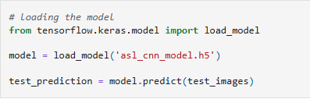
Model Refinement and Testing
Refinement Strategy
Enhanced model generalization and efficiency via:
Early stopping to mitigate overfitting
Use of dynamic visualizations for real-time metric analysis
Clear separation of training and validation sets for reliable performance monitoring
Test Data Preparation
Test dataset underwent identical preprocessing as training data:
Normalization
Resizing
Notes:
FTs like precision agriculture, remote sensing & AI-powered forming equipment can help increase agricultural productivity in LDCs. This can improve fiid security & contribute to the achievement of SDG 2 (Zero Hunger).

Slide 14
Results
Notes:
FTs like precision agriculture, remote sensing & AI-powered forming equipment can help increase agricultural productivity in LDCs. This can improve fiid security & contribute to the achievement of SDG 2 (Zero Hunger).

Slide 15
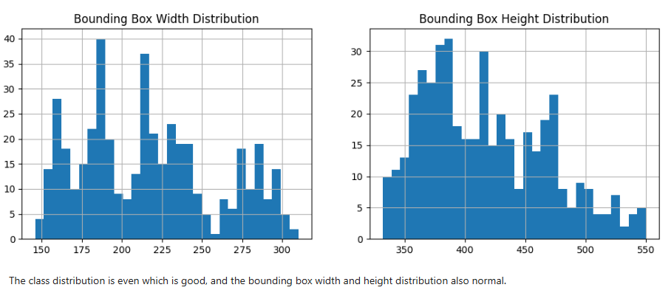
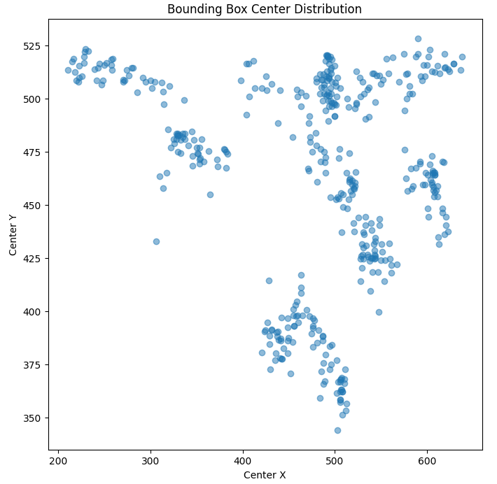
Evaluation Results
Test Accuracy: 94.12%
Validation Accuracy: 98.84%
Test Loss: 0.1709
Validation Loss: 0.0711
Key Observations:
Strong generalization from validation to test set
No significant signs of overfitting due to early stopping
High accuracy confirms robust gesture classification
Notes:
FTs like precision agriculture, remote sensing & AI-powered forming equipment can help increase agricultural productivity in LDCs. This can improve fiid security & contribute to the achievement of SDG 2 (Zero Hunger).

Slide 16
Deployment
The deployment phase aimed to make the Amharic Sign Language (ASL) translator accessible through a user-friendly web application using Streamlit.
The final trained model was saved in HDF5 (.h5) format to allow easy reuse and integration.
Deployment Steps:
TensorFlow/Keras for model training and saving.
Trained and evaluated the final model.
Serialized the model using HDF5 (.h5) format.
Developed a web interface allowing users to upload gesture images
Notes:
FTs like precision agriculture, remote sensing & AI-powered forming equipment can help increase agricultural productivity in LDCs. This can improve fiid security & contribute to the achievement of SDG 2 (Zero Hunger).

Slide 17
Future Work
To enhance the impact and scalability of the ASL translation system, future improvements will focus on:
Dataset Expansion
Increase the number of gesture classes and include more diverse signers to improve model generalization.
Video Stream Input
Integrate real-time video processing for continuous gesture recognition, enabling full sentence translation.
Advanced Models
Experiment with Vision Transformers (ViT) or Hybrid CNN-LSTM architectures for better temporal understanding.
Multilingual Support
Extend translation beyond Amharic to support other Ethiopian sign languages and dialects.
Notes:
FTs like precision agriculture, remote sensing & AI-powered forming equipment can help increase agricultural productivity in LDCs. This can improve fiid security & contribute to the achievement of SDG 2 (Zero Hunger).

Slide 18
References
Goodfellow, I., Bengio, Y., & Courville, A. (2016). Deep Learning. MIT Press.
TensorFlow Documentation – https://www.tensorflow.org
Plotly Official Docs – https://plotly.com/python/
Albawi, S., Mohammed, T. A., & Al-Zawi, S. (2017). Understanding of a Convolutional Neural Network. 2017 International Conference on Engineering and Technology (ICET).
UN Sustainable Development Goals (SDGs) – https://sdgs.un.org/goals
Teshome, A., & Alemayehu, Y. (2022). Amharic Sign Language Recognition Dataset [Data set]. Mendeley Data. https://data.mendeley.com/datasets/5d3nkyhsrf/1
Notes:
FTs like precision agriculture, remote sensing & AI-powered forming equipment can help increase agricultural productivity in LDCs. This can improve fiid security & contribute to the achievement of SDG 2 (Zero Hunger).

Slide 19

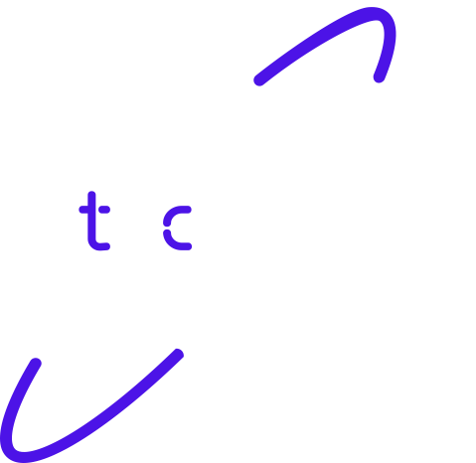
Thank you!

